Slide 1
Attendance Management System

Slide 2
Introduction:
This project helps Teachers to take attendance and store, fetch data from mysql db using server (php).

Slide 3
Features
Beautiful Login Screen.
Teachers will be able to take attendance and save in database on server.
Fetch attendance data according to calendar date selection.

Slide 4
How it works
First Teachers/Mentor/Other Login from Login Screen (currently user login is predefined in mysql)
Select Subject Name.
Select Time, Batch, Status(present/absent).
Select roll no.
When submit button selected, all selected roll no is saved on mysql database (backend php server).
Check record of attendance data from attendance View section, Which display student present/absent from selected date.

Slide 5
GuideLines

Slide 6
Setup:-
Create demo2 database in mysql (from localhost/phpmyadmin).
Select demo2 and import database file (from database folder/demo2.sql).
Browse to c/wamp/www/create/ or c/xammp/htdocs/ create attendance folder and paste all php files inside attendance folder (from php/attendance).

Slide 7
Change IP address in com/java/attendance/misc/utils/Constants.java file
public static final String LOGINURL = "http://192.168.0.102/attendance/login.php"
public static final String INSERTATTEND = http://192.168.0.102/attendance/insertAttendance.php
public static final String VIEWATTENDANCE = http://192.168.0.102/attendance/viewAttendance.php
public static final String QUICKATTENDANCE = "http://192.168.0.102/attendance/quickAttendance.php"

Slide 8
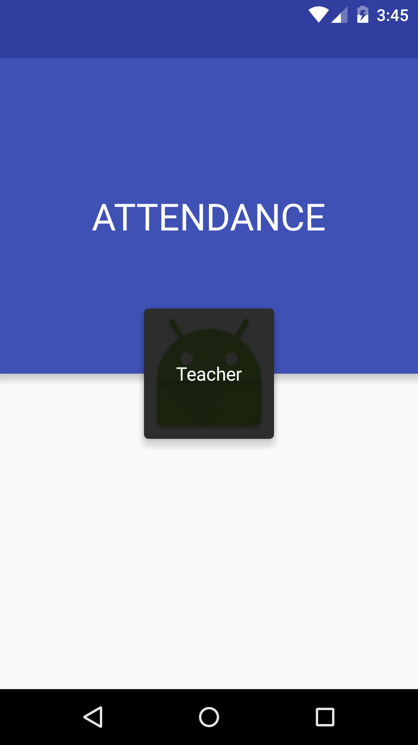
Screen shots

Slide 9
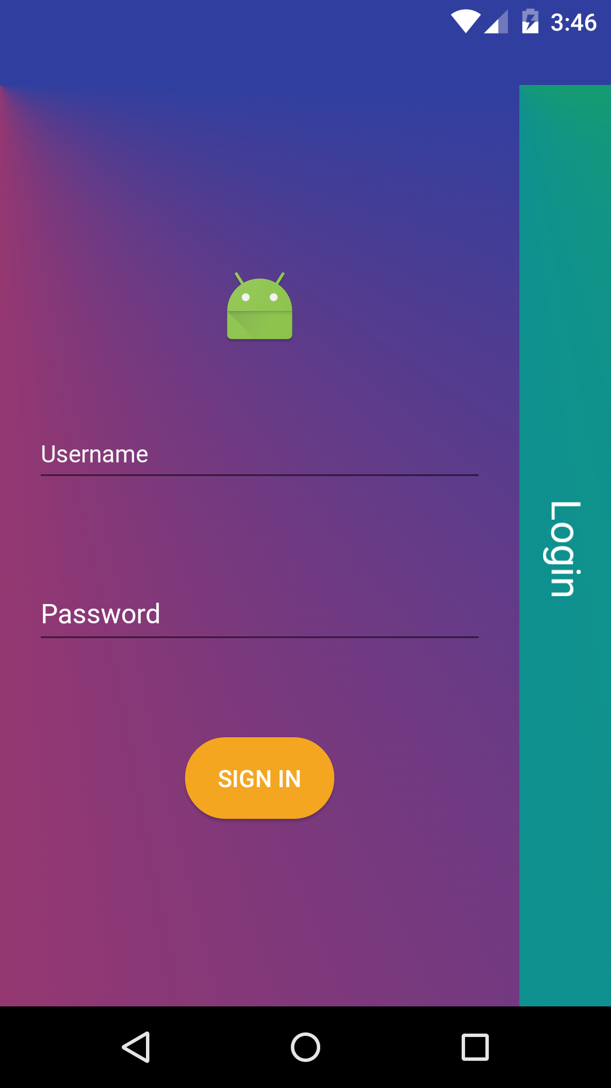

Slide 10
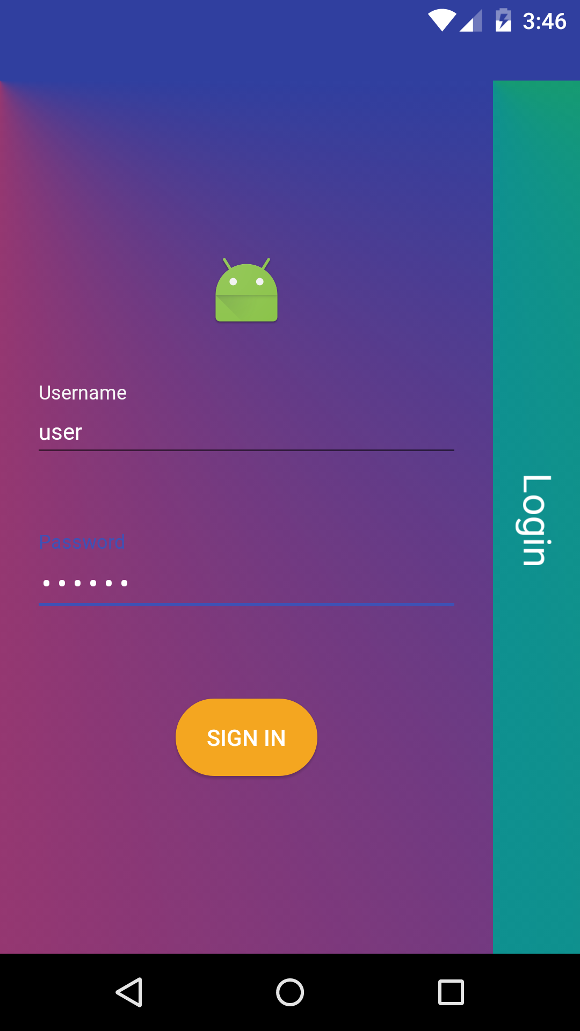

Slide 11
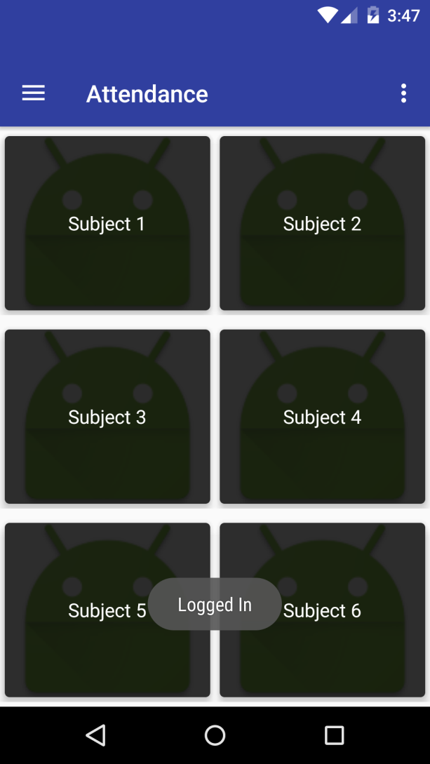

Slide 12
Thank You

